Slide 2
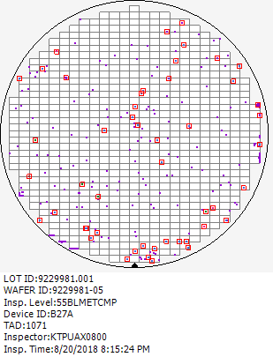
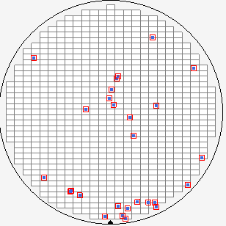
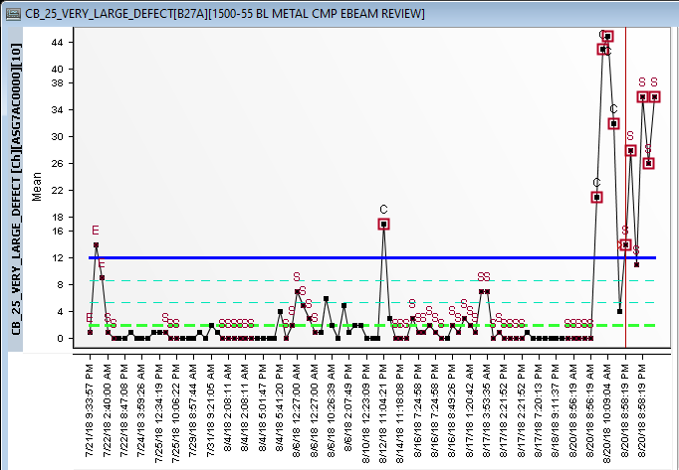
B27A_1000-55 BL METAL CMP MICRO INSP
CB25 VERY LARGE DEFECT –ZCMP22SPCR9.5PROC
Issue
B27A 9229981.001 (4/4) Fail CB25 Very Large Defect
Root Cause
ZCMP22SPCR9.5PROC
(1.Conversion background and motivation
−CR 9.5 ALD/RTO splits with Fresco Nit Backside Dep post poly dep 4
for stress relieve observed lower Goodness of Fit (GOF) at pre and post measurement of 22PCMP
-Delta thickness mean is lower as well, thus to create attribute for process separation to prevent R2R false tuning
Large defect
2 lots

Slide 3
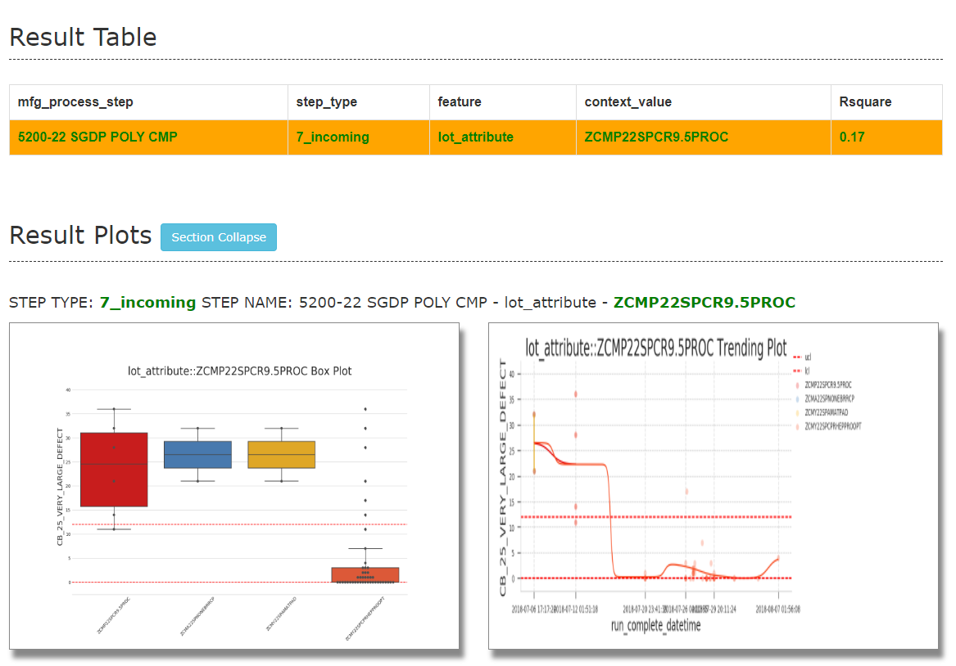
http://fslhdppds01/rda_ad/ad_hoc/2018-08-21/10_600340_0_Mean_2018082100.html

Slide 4
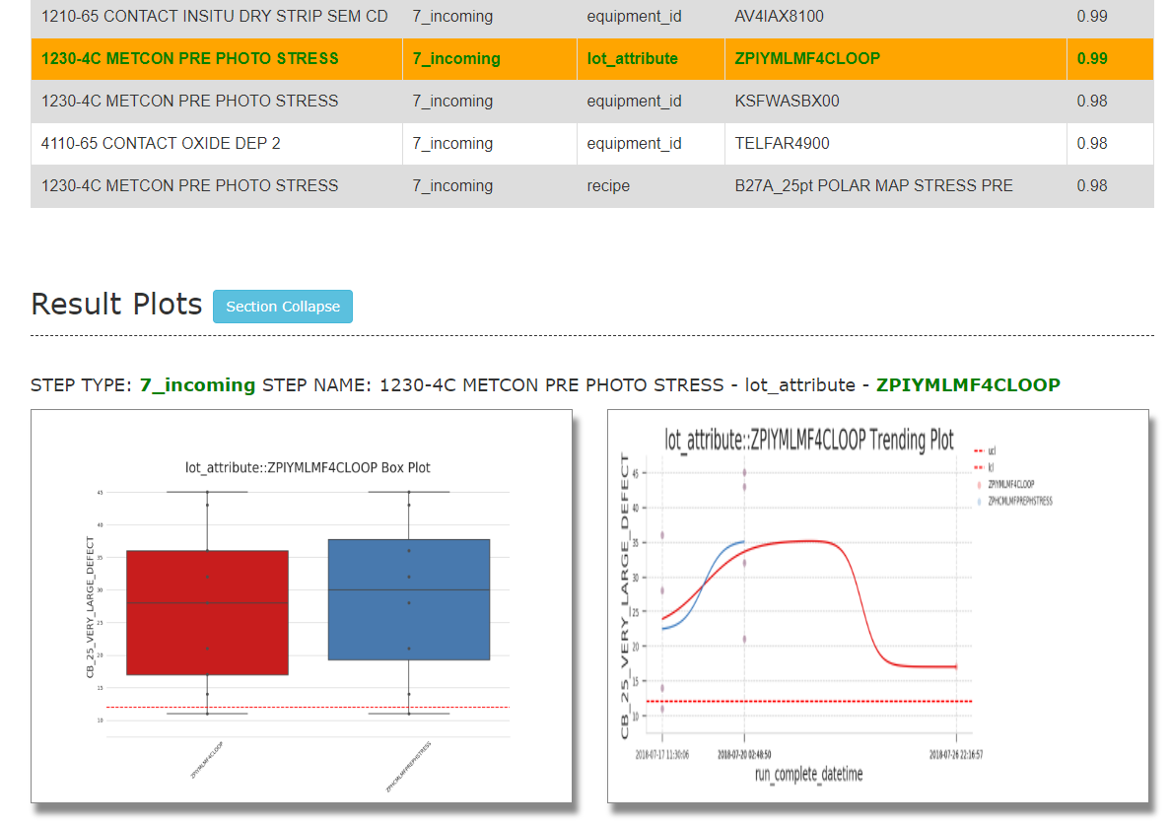

Slide 5
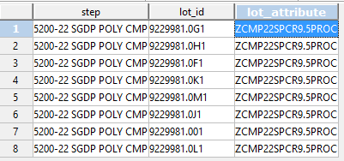

Slide 6
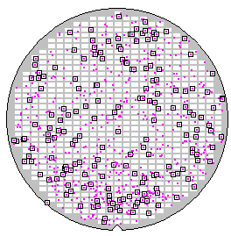
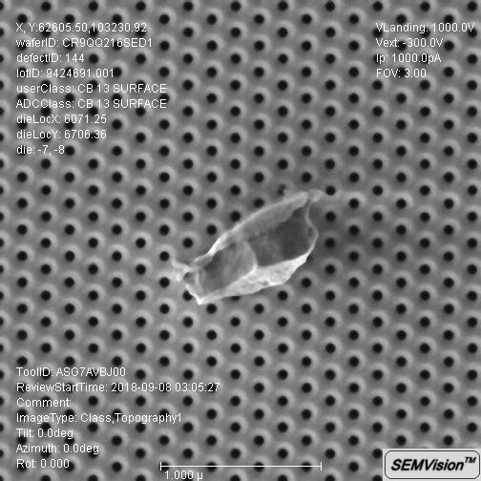
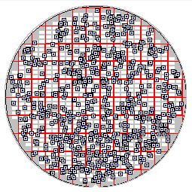
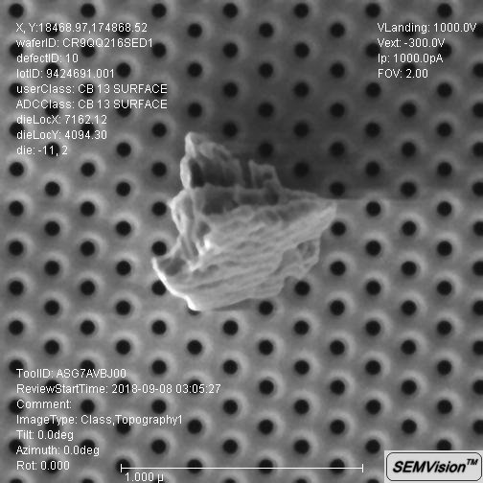
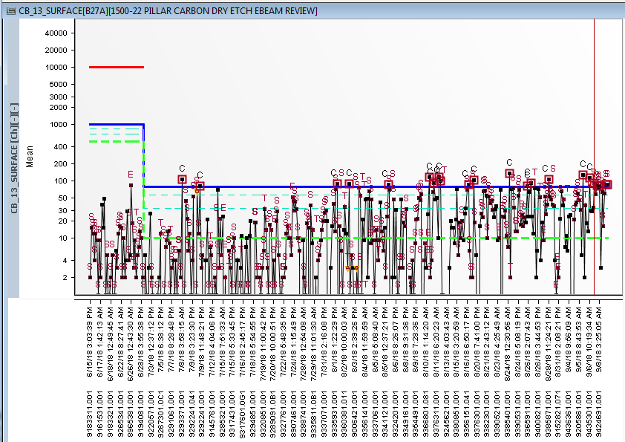
B27A_1000-22 PILLAR CARBON DRY ETCH MICRO INSP
CB13 Surface – Attribute ZDEY22MPDDEIDEW5HXP
Issue
B27A Surface baseline shifted since 08/01 ( RDA inspection time )
Rootcause
Suspect Attribute : ZDEY22MPDDEIDEW5HXP related
Conversion background and motivation This conversion is to evaluate 22L W5 Package comprising of 22DDE ME0 with Hydra coupled with 22INT DE W5 Recipe on 22HXP Final configuration hardware (Corvus-T+CIP Combo)
Conversion Rate: 100%
Cumm Map
Surface

Slide 7
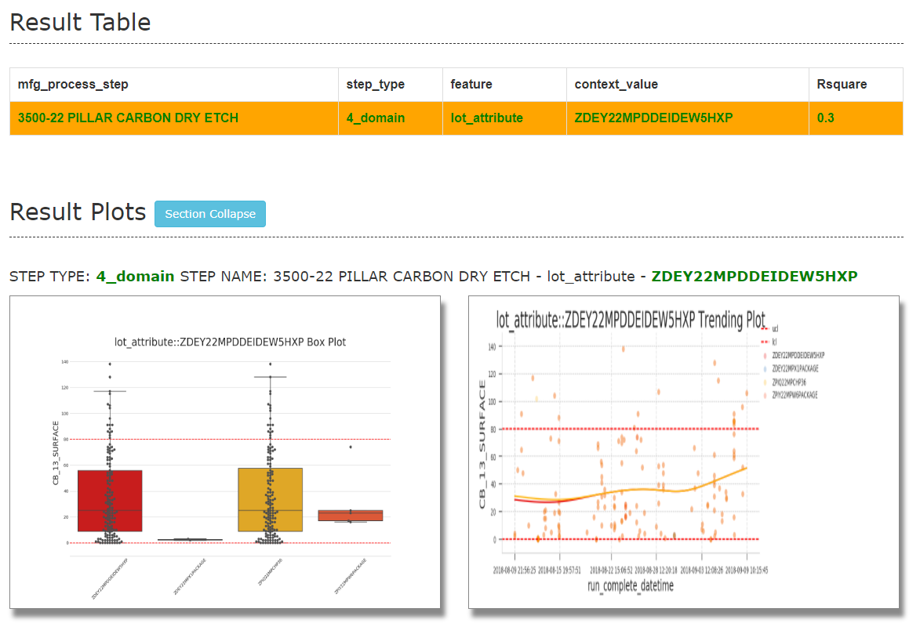
http://fslhdppds01/rda_ad/ad_hoc/2018-09-09/10_705907_0_Mean_2018090920.html

Slide 8
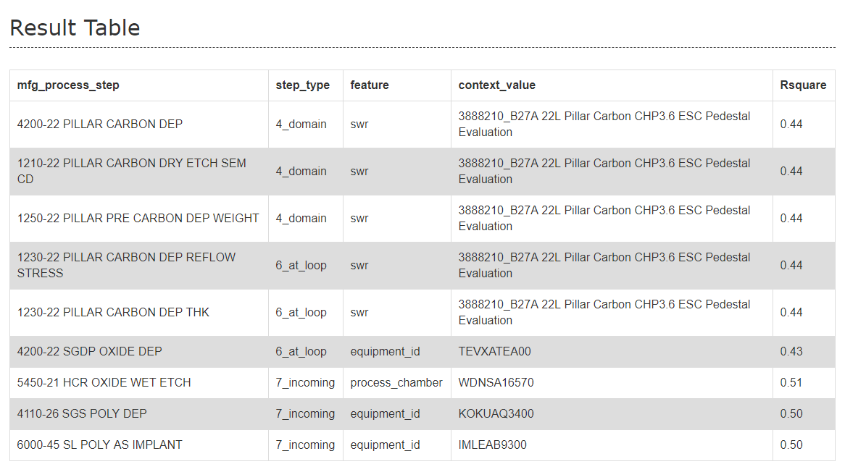

Slide 9
